Slide 1
ELECTRIC PARKING BRAKE SYSTEMS
doc. Juraj PANČÍK
PRESENTATION WILL BE FOUND AT: www.drpancik.sk
PROFILE: https://www.linkedin.com/in/juraj-pancik-phd-36794a53/?originalSubdomain=sk
KME FEIT UNIZA

Slide 2
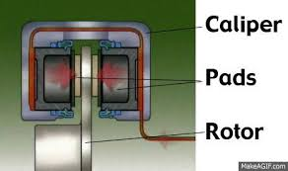
Introduction
Hydraulic brake calipers are a vital part of your vehicle's braking system. Brake calipers squeeze the brake pads against the surface of the brake rotor to slow or stop the vehicle.
Hydraulic brake calipers are essential to your car's ability to stop and are arguably one of the most important automobile brake parts.
Most cars today have disc brakes, at least for the front wheels, anyway. But a lot of cars and trucks are now using disc brakes in the rear, too.
In a disc-braking system the car's wheels are attached to metal discs, or rotors, that spin along with the wheels.
The job of the caliper is to slow the car's wheels by creating friction with the rotors.

Slide 3
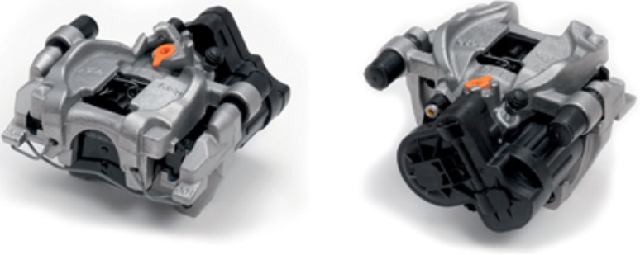
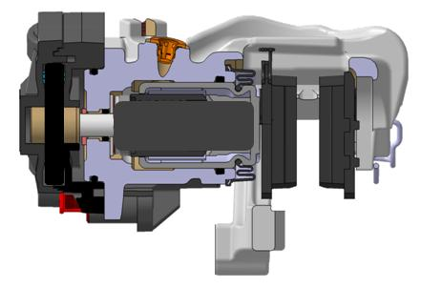
Introduction - Caliper integrated EPB
Components of the calipers with integrated Electronic Parking Brakes are :
Hydraulic brake caliper (incl. anchor, springs, bearings)
Brake disc
Brake pads
Motor-Gear-Unit (MGU)
Electronic Stability Control (ESC) system
All above components are mentioned in our article as automotive components and we deal with their fatigue tests machines
PHOTO TAKEN FROM : Mr. Christian Quasten; Dr. Gunther Seipel; Mr. Sebastian Fischer Continental AG, Frankfurt, Germany : The influence of brake ad properties on the hill hold performance of a caliper integrated EPB-System at Euro Brake Conference 2016, MILAN, Italy

Slide 4
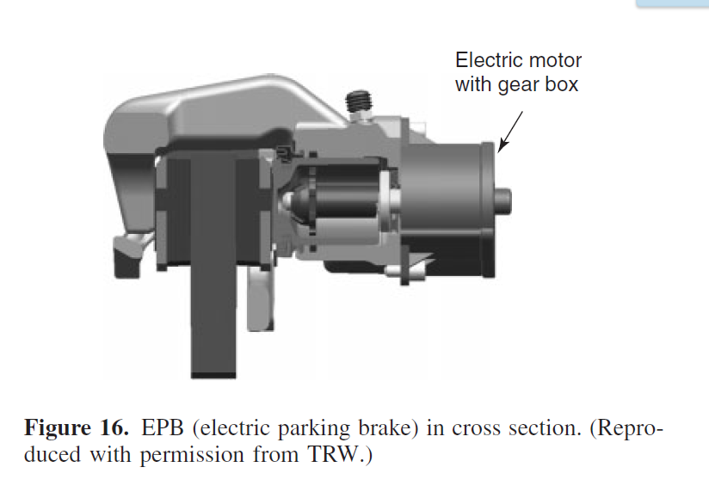
Encyclopedia of Automotive Engineering Online ISBN: 9781118354179
Editor(s): Professor David Crolla; Professor David E. Foster; Professor Toshio Kobayashi; Professor Nicholas Vaughan
Wiley, 2017

Slide 5
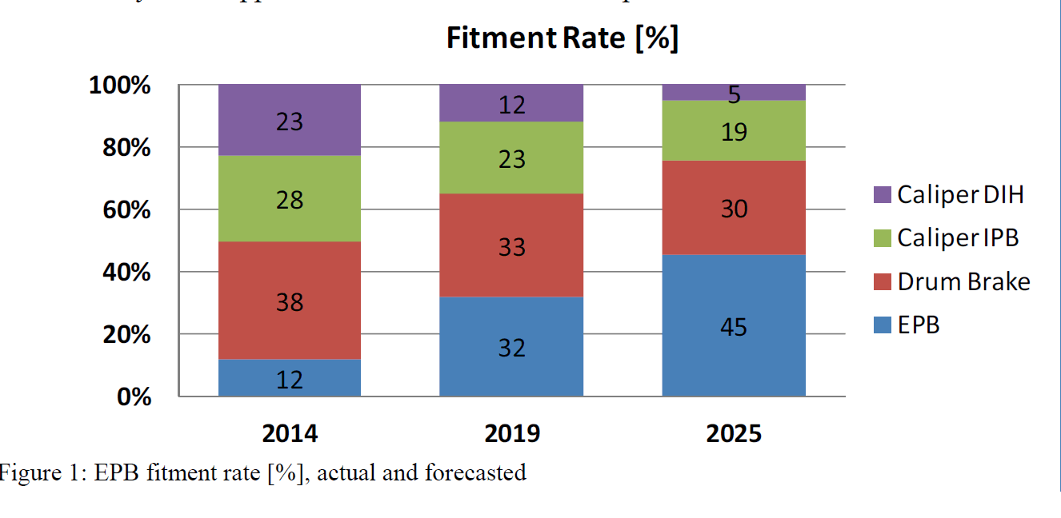
Caliper integrated EPB – forecasting
GRAPH TAKEN FROM : Dr. Reitz, Andreas, Loehr, Bert, Kohrt, Jens-PeterZF-TRW Active & Passive Safety Technology, Germany : HARMONISATION OF THE RELEASE PROCESS FOR ELECTRIC PARKING BRAKE SYSTEMS at Euro Brake Conference 2016, MILAN, Italy

Slide 6
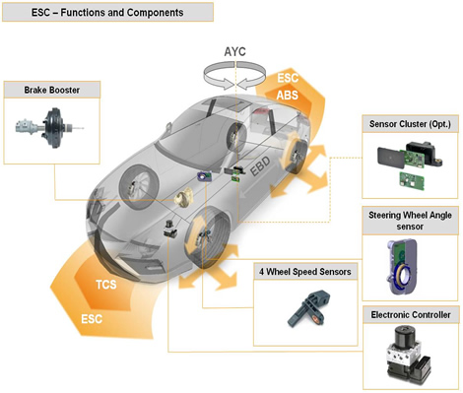
Introduction - Electronic Stability Control (ESC) and EPB
Electronic Stability Control (ESC) is an active safety system that recognizes unstable driving conditions at the very outset and applies automatic and immediate, corrective action, if necessary.
ESC, presently the most important active safety system, prevents critical vehicle states from developing. The system constantly evaluates the data from the wheel speed sensors, the steering angle sensor, the yaw rate and lateral acceleration sensor and compares the driver’s input with the vehicle’s actual behavior. If an unstable state is detected, for instance as the result of a sudden direction change, ESC responds in milliseconds and stabilizes the vehicle through wheel-specific brake intervention and adjustment of the engine torque.
ESC is the sum of the following functions:
ABS Anti-lock Brake System
EBD Electronic Brake force Distribution
TCS Traction Control System
AYC Active Yaw Control
Source :
http://www.continental-automotive.com/www/automotive_de_en/themes/passenger_cars/chassis_safety/ved/ebs_family_en.html?page=3

Slide 7
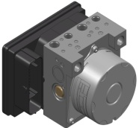
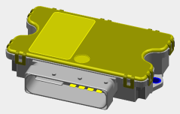
MK100ESC + IPB (integrated parking brake)
IPB
Functions
Static Apply and Release
DAR (Drive Away Release)
Dynamic Brake Function via ESC and/or IPB actuator
Hot Disk Re-clamp
Roller dyno detection
Technical Data IPB
Clamping force : up to 18 kN
Apply time: ~1,0s to Fmax
Release time: ~0,8s
Life time: 100.000 cycles with Fmax
all known EPB functions available
Actuator
2x Motor
EPB
Switch
Switch
hydraulic
12V
ESC
CAN
2x CAN H/L
2x Motor
hydraulic
Cable length ~7,5m
single way
ESC ECU
Actuator
EPB ECU
MK100 + IPB

Slide 8
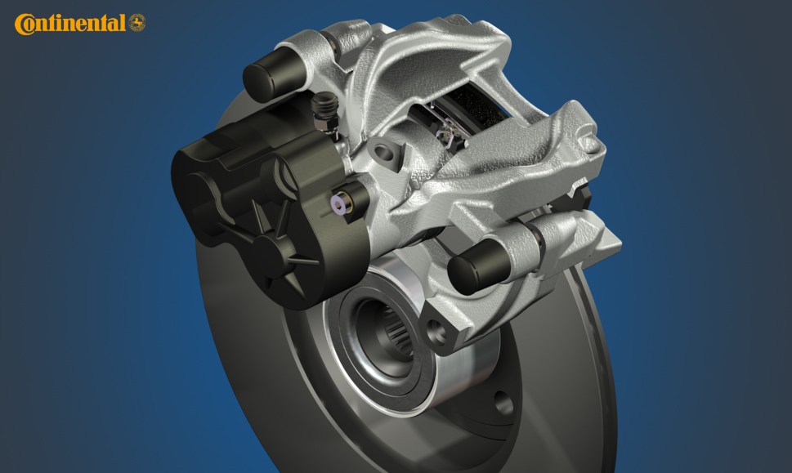
IPB – Integrated Parking Brake

Slide 9
IPB caliper in sectioning

Slide 10
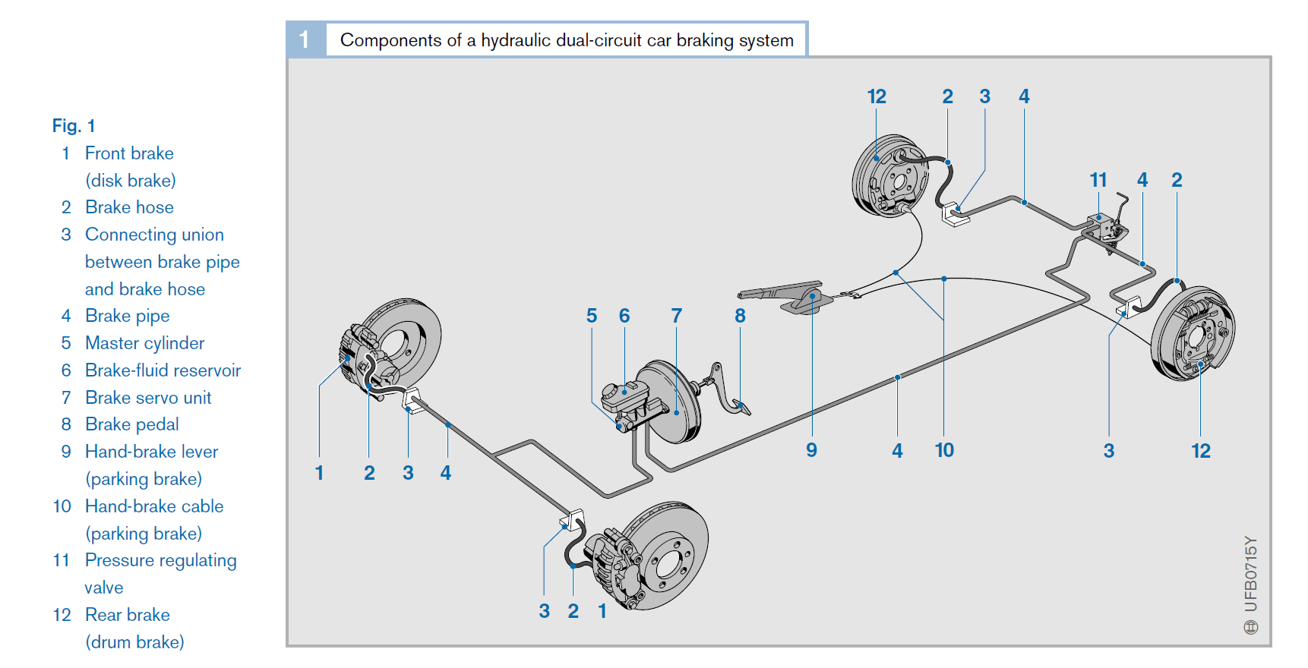
K. Reif (Ed.), Brakes, Brake Control and Driver Assistance Systems, Bosch Professional
Automotive Information, DOI 10.1007/978-3-658-03978-3_4, © Springer Fachmedien Wiesbaden 2014

Slide 11
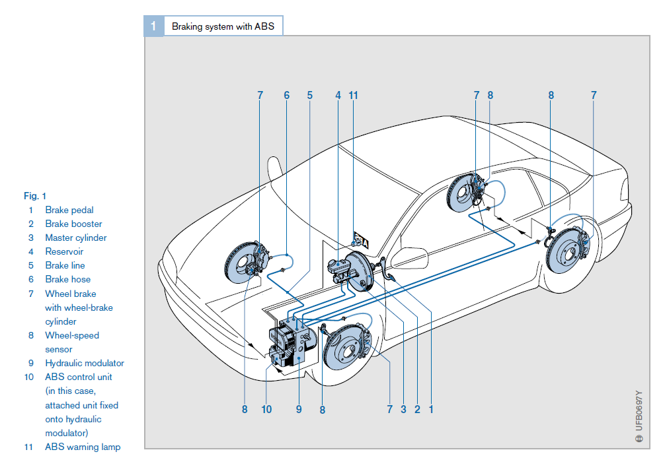
K. Reif (Ed.), Brakes, Brake Control and Driver Assistance Systems, Bosch Professional
Automotive Information, DOI 10.1007/978-3-658-03978-3_4, © Springer Fachmedien Wiesbaden 2014

Slide 12
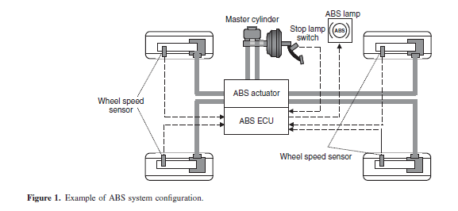
Encyclopedia of Automotive Engineering Online ISBN: 9781118354179
Editor(s): Professor David Crolla; Professor David E. Foster; Professor Toshio Kobayashi; Professor Nicholas Vaughan
Wiley, 2017

Slide 13
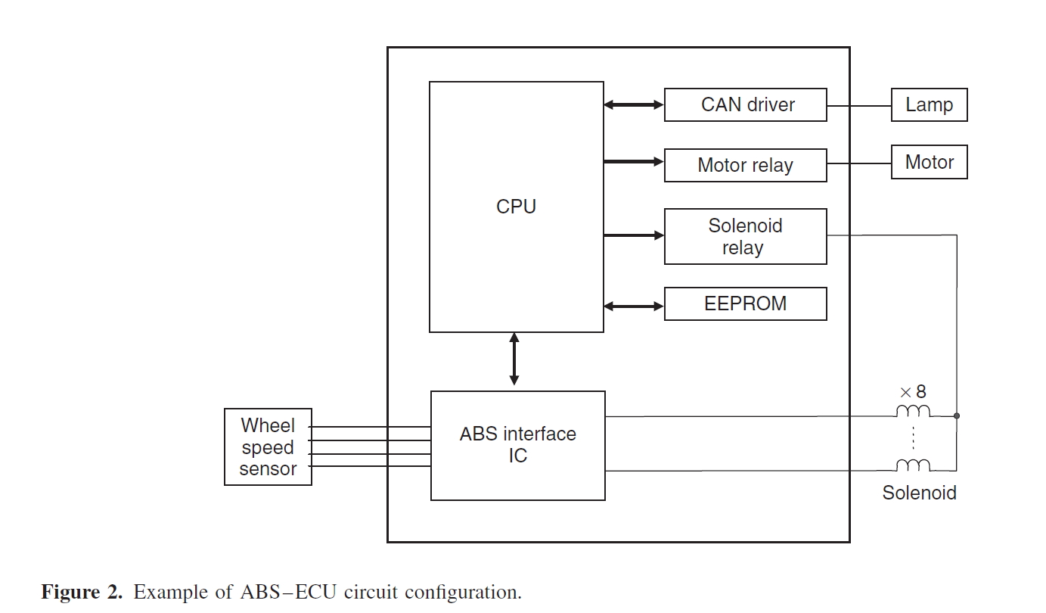
Encyclopedia of Automotive Engineering Online ISBN: 9781118354179
Editor(s): Professor David Crolla; Professor David E. Foster; Professor Toshio Kobayashi; Professor Nicholas Vaughan
Wiley, 2017

Slide 14
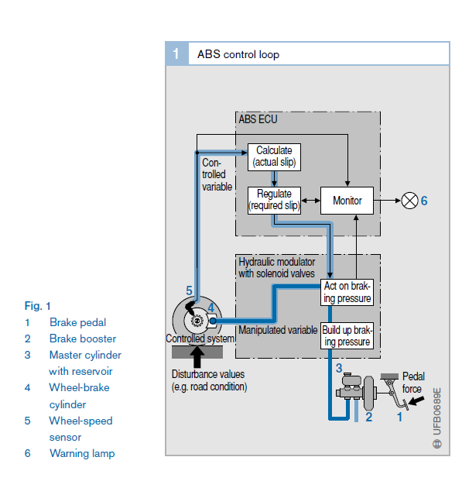
K. Reif (Ed.), Brakes, Brake Control and Driver Assistance Systems, Bosch Professional
Automotive Information, DOI 10.1007/978-3-658-03978-3_4, © Springer Fachmedien Wiesbaden 2014

Slide 15
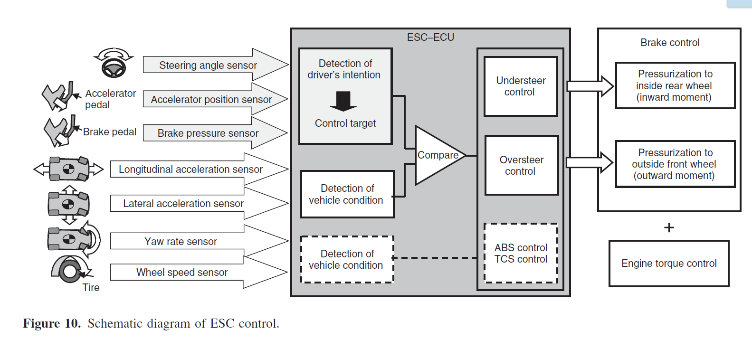
Encyclopedia of Automotive Engineering Online ISBN: 9781118354179
Editor(s): Professor David Crolla; Professor David E. Foster; Professor Toshio Kobayashi; Professor Nicholas Vaughan
Wiley, 2017

Slide 16
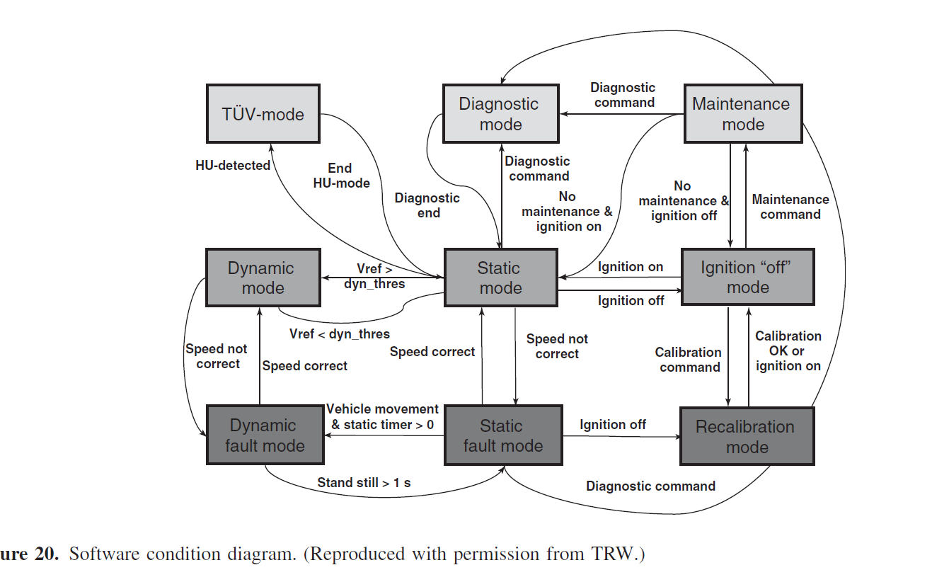
Encyclopedia of Automotive Engineering Online ISBN: 9781118354179
Editor(s): Professor David Crolla; Professor David E. Foster; Professor Toshio Kobayashi; Professor Nicholas Vaughan
Wiley, 2017

Slide 17
V-model DEVELOPMENT PHASES

Slide 18
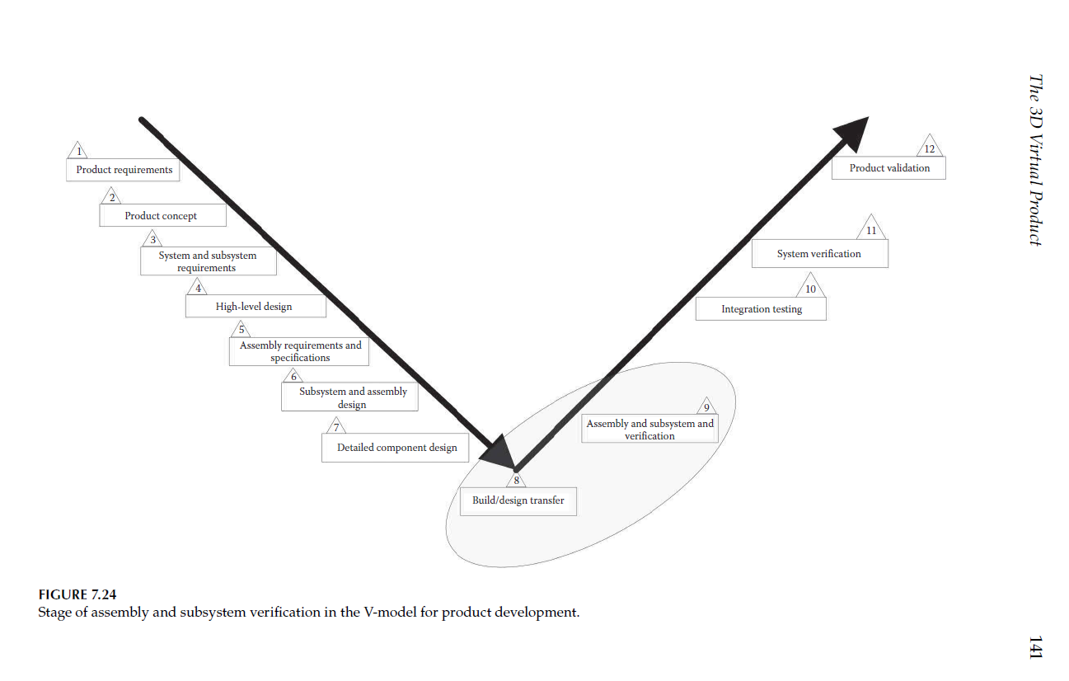
Encyclopedia of Automotive Engineering Online ISBN: 9781118354179
Editor(s): Professor David Crolla; Professor David E. Foster; Professor Toshio Kobayashi; Professor Nicholas Vaughan
Wiley, 2017

Slide 19
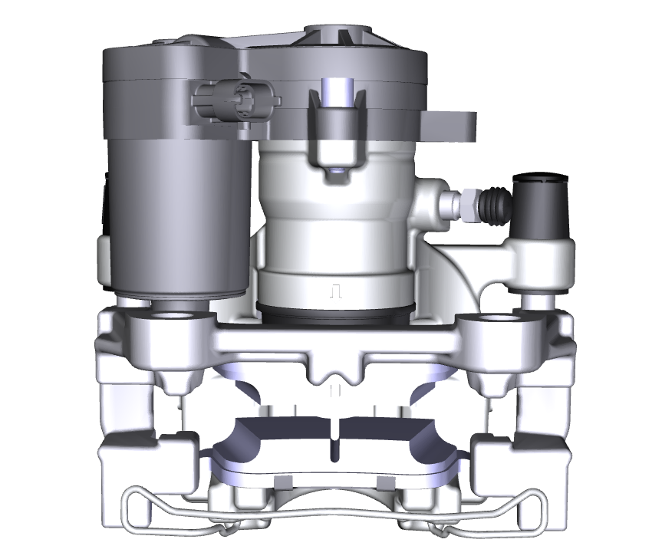
Electronic Parking Brake (EPB) Nomenclature (1 of 4)
Motor Gear Unit (MGU)
Electrical Connector on MGU
Bleed Screw
Bleeder (or Dust) Cap
(Not Visible)
Ball Screw Assembly
w/ O-Ring
Piston
Piston Seal
Dust Boot
Guide Pin
Anchor
Inner Pad
Outer Pad
Housing Clip (or Spring)

Slide 20
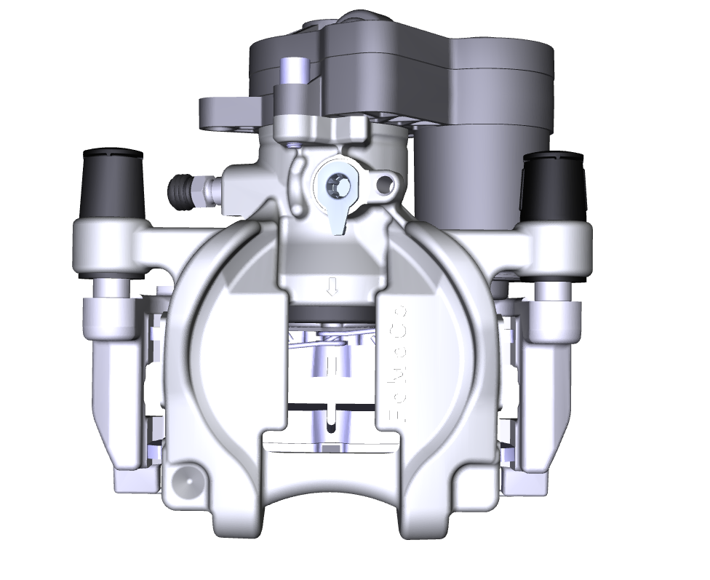
Electronic Parking Brake (EPB) Nomenclature (2of 4)
Protection Plugs
Inlet Protection Plug
Bushings
Hose Anti -Rotation Hole
Housing

Slide 21
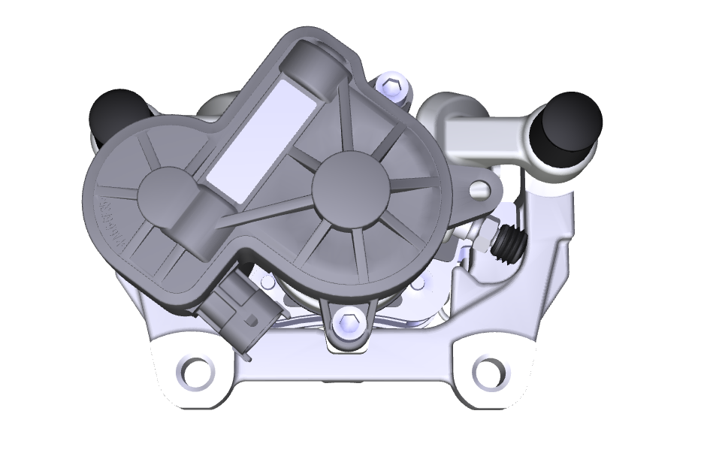
Electronic Parking Brake (EPB) Nomenclature (3 of 4)
Identification Label
Julian Date Code Area
MGU Data Matrix Code
Head Cap Screws

Slide 22
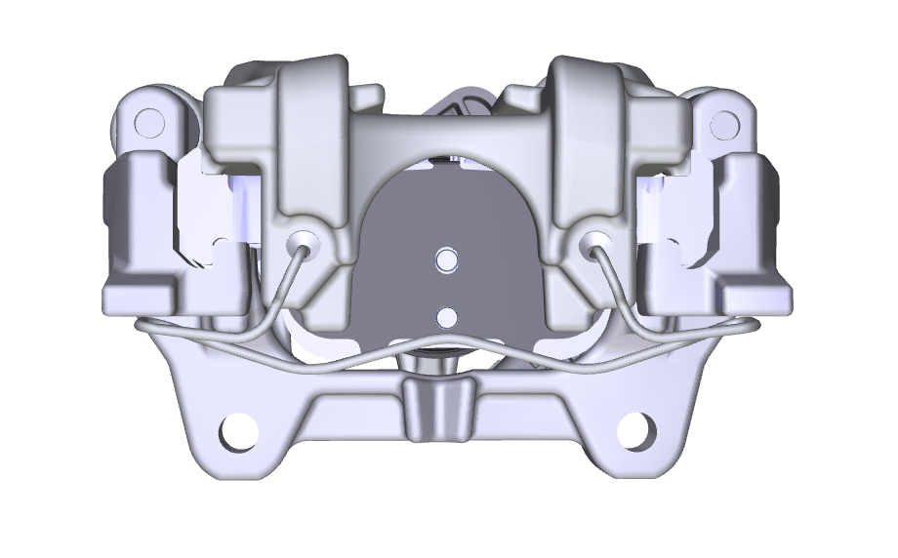
Electronic Parking Brake (EPB) Nomenclature (4 of 4)
Backplate of Outer Pad
Anchor Mounting Threads

